Slide 1
Scalable Machine Learning with Spark & R Server - Workshop
Sree Ram - Solution Architect Data & AI
Notes:
aka.ms/mlads2017r

Slide 2



Microsoft Machine learning

Slide 3
ML Components
Developer Tools
TRAIN & DEPLOY OPTIONS
Experimentation and Model Management
AZURE
Spark
SQL Server
Virtual machines
GPUs
Container services
Machine Learning Server
AI dev /
data scientist
workstation
CPU/GPU
ON-PREMISES
Notebooks
IDEs
Azure Machine Learning Workbench
Azure IoT Edge
EDGE COMPUTING
Notes:
On the left we have left we have R client which offers two things to data scientists
They can leverage all the Microsoft R packages locally on their workstations
Second, they can push the compute and bid data analytics to where the data lives. This gives them access to the power of servers and eliminates need for data movement, reducing time and increasing security
On the right is our commitment of meeting customers where they are, and where their data lives.

Slide 4
ML SERVICES Continued..
Developer Tools & Services
AI Applications (1st & 3rd party) Cognitive Services Bot Framework
Open platform for data science
Azure Machine Learning
Experimentation management, data prep, & collaboration
Model deployment & management
Machine Learning toolkits
Docker
Cloud – Spark, SQL, other engines
ML Server – Spark, SQL, VMs
Edge
CNTK
Tensor flow
ML Server
Scikit-Learn
Other Libs.
PROSE
Hyper scale, enterprise-grade infrastructure
Software
Spark AI Batch Training DS VM SQL Server ACS
Storage management
BLOB Cosmos DB SQL DB/DW ADLS
Hardware
CPUs FPGA GPUs IoT

Slide 5
Data Science Workloads - Compute + Storage

Slide 6
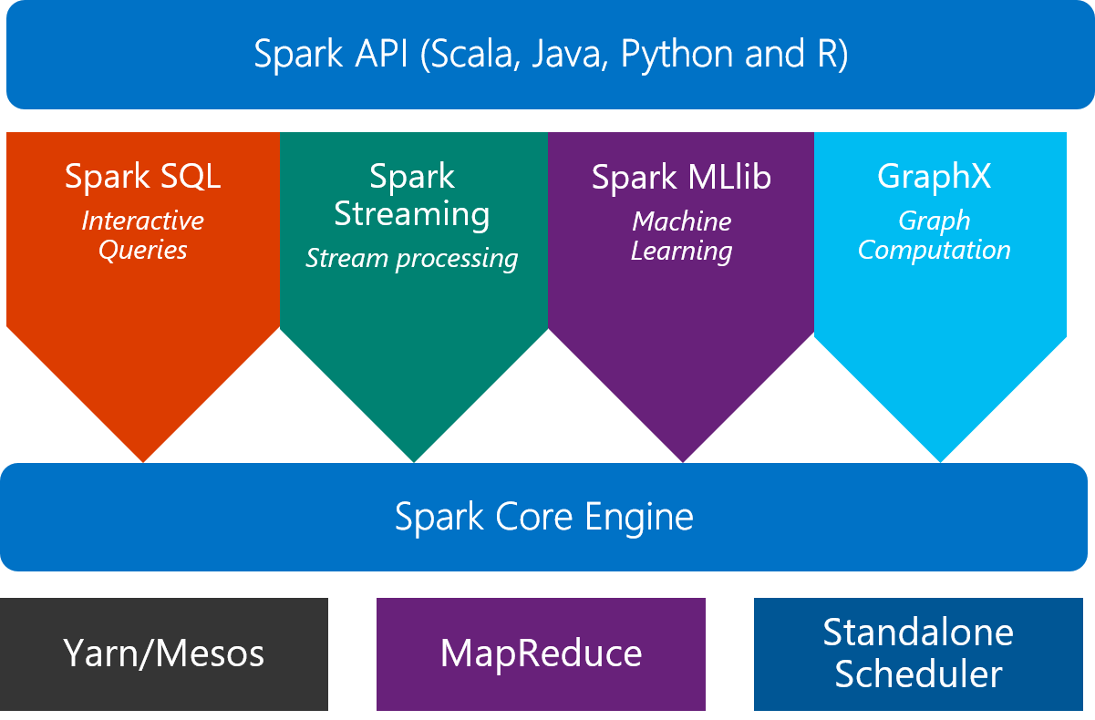
Spark Cluster
What is Spark?
An unified, open source, parallel, data processing framework for Big Data Analytics

Slide 7
R Server
A portable server for multiple platforms
Windows
Linux
HDInsight
Cloud
Hortonworks
Cloudera
MapR
Hadoop & Spark
R Server Technology
R Server portfolio
EDW
SQL Server 2016
Teradata Database
R+CRAN
Microsoft R Open
Operationalization
DistributedR
RDBMS
SQL Server 2016 EE
SQL Server 2016 SE
ConnectR
Desktops & Servers
Windows
Linux (Ubuntu, SUSE, RedHat)
ScaleR
high-speed and direct connectors to HDFS, Teradata, SAS and etc.
provides fully-parallelized analytics
includes distributed computing framework and cross-platform portability
“mrsdeploy” establishes remote execution and publishes & manages web services
7

Slide 8
Resource sharing using spark and R
Edge node
YARN
R Tools for VS
SSH
R server
Default Queue
R Studio
Spark Application
DeployR
Spark Application
IntelliJ IDEA
Head node
Spark Application
REST
Jupyter notebooks
Livy server
ODBC
Thrift Queue
BI Tools
Thrift server
Spark Application

Slide 9
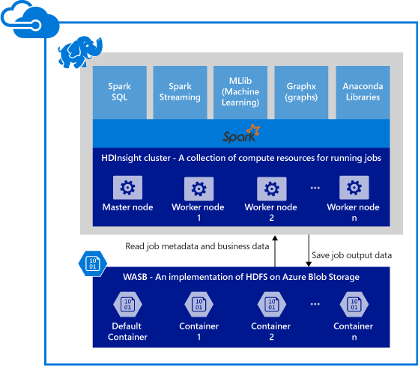


Spark and R Server clusters in Azure HDInsight
Provisions Azure compute resources with Spark 2. 1 installed and configured.
Supports multiple versions (e.g. Spark 1.6, 2.x).
R Edge node
Stores data in Azure Blob storage (WASB), Azure Data Lake Store or Local HDFS.
Edge
9

Slide 10
General analytical workflow – Multiple toolkits
Ingest into Spark DF
Wrangling and cleanup (dplyr, rxMerge, Spark SQL, etc.)
Creation of ML models in Spark
+
Model evaluation
Exploration and visualization
(for visualization, sampled data may need to be converted to R dataframe)
Transfor-mation and Featurization
(featurization functions, rxDataStep, Spark SQL, etc.)
Save models for deployment
Spark dataframes used multiple times in the workflow should be cached in memory
10

Slide 11
Machine learning using spark ML

Slide 12
Challenges when using Spark for ML
User needs to write lots of “ceremonial” code to prepare features for ML algorithms.
Coerce types and data layout to that what’s expected by learner
Use different conventions for different learners
Lack of domain-specific libraries: computer vision or text analytics…
Limited capabilities for model evaluation & model management

Slide 13
Vision of Microsoft Machine Learning Library for Apache Spark
Enable you to solve ML problems dealing with large amounts of data.
Make you as a professional data scientist more productive on Spark, so you can focus on ML problems, not software engineering problems.
Provide cutting edge ML algorithms on Spark: deep learning, computer vision, text analytics…
Open Source at GitHub

Slide 14

Microsoft Machine Learning Library for Apache Spark (MMLSpark)
GitHub Repo: https://github.com/Azure/mmlspark
Get started now using Docker image:
docker run -it -p 8888:8888 -e ACCEPT_EULA=yes microsoft/mmlspark
Navigate to http://localhost:8888 to view example Jupyter notebooks

Slide 15
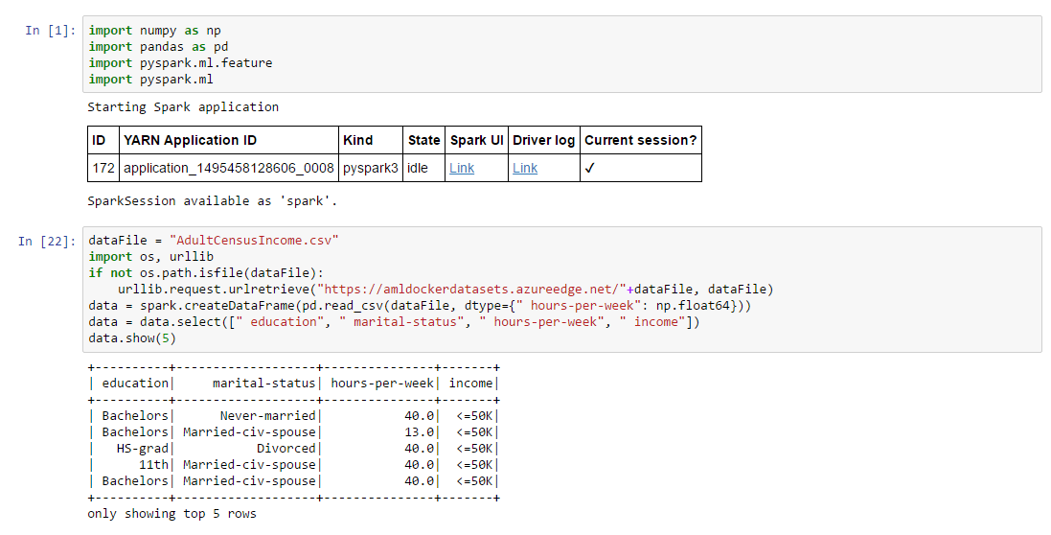
Using Plain PySpark

Slide 16
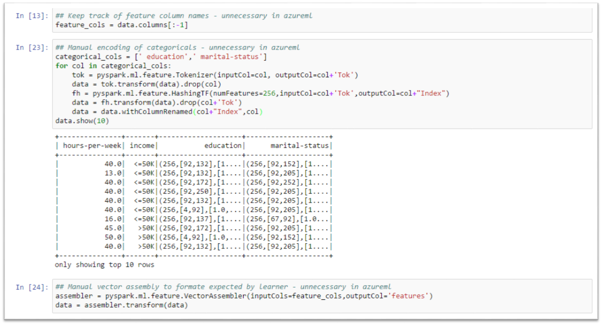

Slide 17
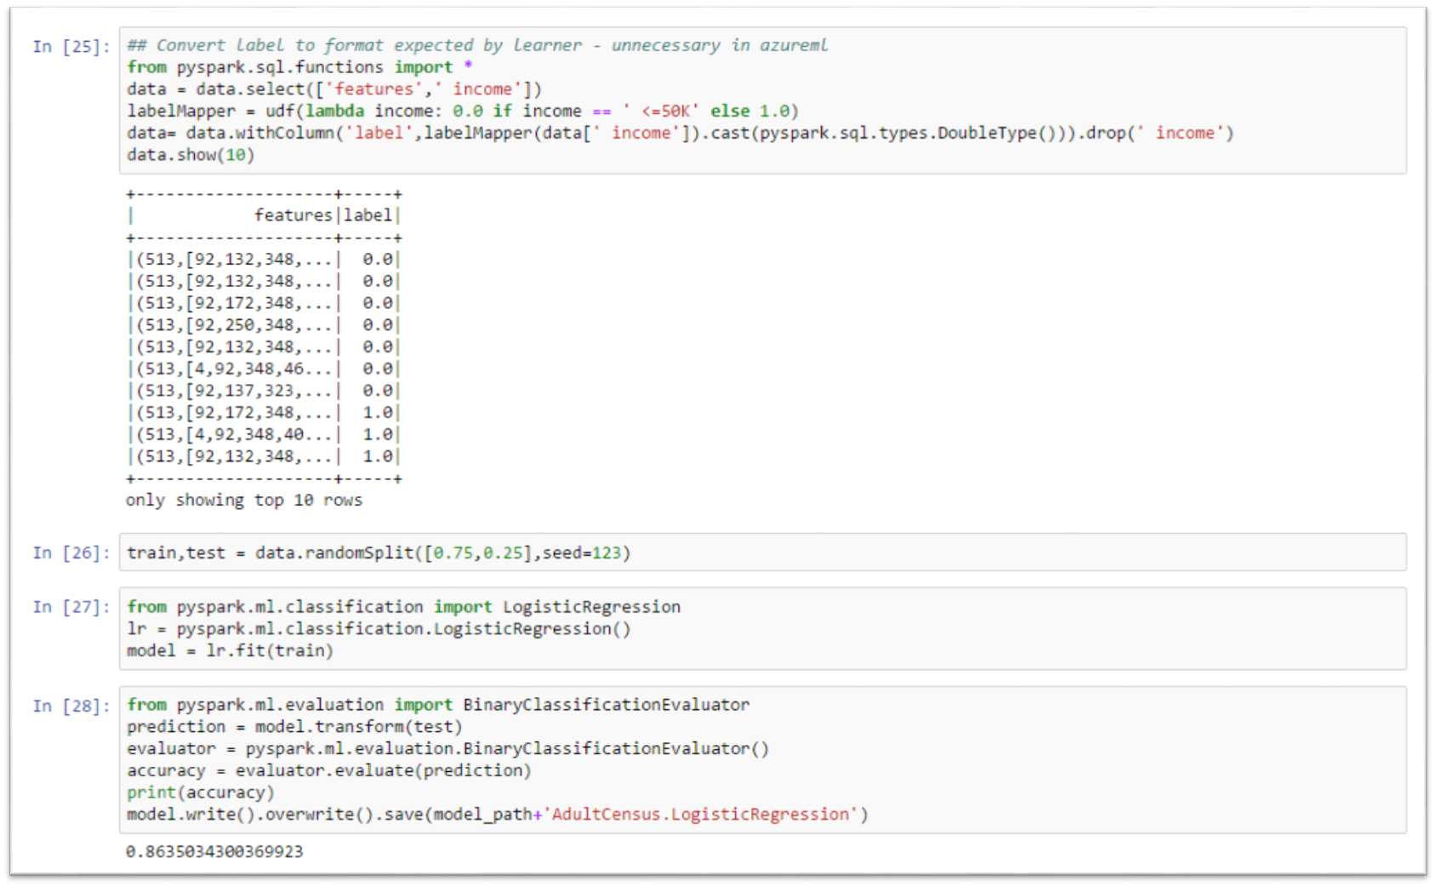

Slide 18
Text Analytics
Goal: provide one-step text featurization capability that lets you take free-form text columns and turn them into feature vectors for ML algorithms.
Tokenization, stop-word removal, case normalization
N-Gram creation, feature hashing, IDF weighing.
Future: multi-language support, more advanced text preprocessing and DNN featurization capabilities.

Slide 19
Example: Text analytics for document classification by sentiment from pyspark.ml import Pipeline from mmlspark import TextFeaturizer, SelectColumns, TrainClassifier from pyspark.ml.classification import LogisticRegression textFeaturizer = TextFeaturizer(inputCol="text", outputCol = "features", useStopWordsRemover=True, useIDF=True, minDocFreq=5, numFeatures=2**16) columnSelector = SelectColumns(cols=["features","label"]) classifier = TrainClassifier(model = LogisticRegression(), labelCol='label') textPipeline = Pipeline(stages= [textFeaturizer,columnSelector,classifier])

Slide 20

SparkR 2.0: a Spark API
An R package provides a light-weight frontend to use Apache Spark from R and allows data scientists to analyze large datasets.
SparkDataFrame is distributed collection of data organized into named columns.
SparkR can create SparkDataFrames from local R data frames, csv, json and parquet files.
With Hive support, it can also access tables from Hive MetaStore.
Pre-configured on Spark clusters in Azure HDInsight.
20

Slide 21
Data processing and modeling with SparkR
Supports functions for structured data processing:
Selections: select(), filter()
Grouping, Aggregations: summarize(), arrange()
Running local R functions distributed: spark.lapply()
Applying UDFs on each partition/group of a SparkDataFrame: dapply(), dapplyCollect(), gapply(), gapplyCollect()
Uses MLlib to train models and allows model persistence.
Generalized Linear Model
Survival regression
Naive Bayes
KMeans
Logistic Regression
Gradient Boosted Tree
Random Forest
… others
21

Slide 22
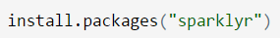
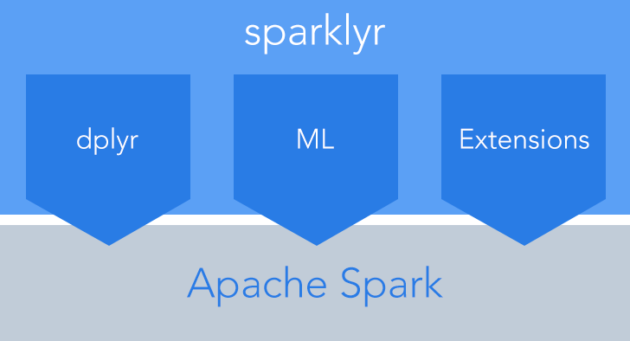
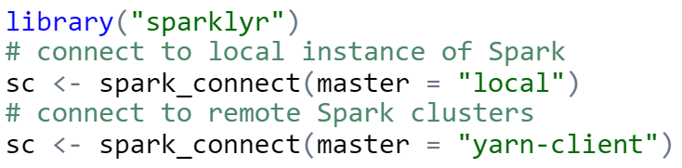
sparklyr: R interface for Apache Spark
Easy installation from CRAN
Connect to both local instances of Spark and remote Spark clusters
Loads data into SparkDataFrame from: local R data frames, Hive tables, CSV, JSON, and Parquet files.
Source: http://spark.rstudio.com/
22

Slide 23
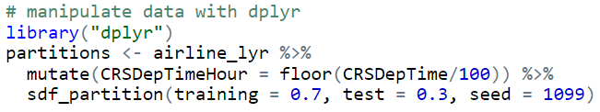
dplyr and ML in sparklyr
Provides a complete dplyr backend for data manipulation, analysis and visualization
%>%
Includes 3 family of functions for machine learning pipeline
ml_*: Machine learning algorithms for analyzing data provided by the spark.ml package.
K-Means, GLM, LR, Survival Regression, DT, RF, GBT, PCA, Naive-Bayes, Multilayer Perceptron, LDA
ft_*: Feature transformers for manipulating individual features.
sdf_*: Functions for manipulating SparkDataFrames.
23

Slide 24
What’s new in MRS 9.0?
MicrosoftML:
High-performance algorithms: rxRastLiner(), rxOneClassSvm(), rxFastTrees(), rxFastForest(), rxNeuralNet(), rxLogisticRegression()
Available in: MRS for Windows, R Client for Windows, SQL Server R Services
Coming soon in Q1 2017: Linux, Hadoop and HDInsight
mrsdeploy (Operationalization):
Provides remote execution on a MRS 9.0 instance
Publishes and manages web services
RevoScaleR:
New data source: RxHiveData(), RxParquetData()
New persistent Spark connection: rxSparkConnect(), rxSparkDisconnect()
Manages data in Spark Dataframes: rxSparkListData(), rxSparkRemoveData()
Supports Spark 1.6 and 2.x

Slide 25
New in R Server 9.1
RevoScaleR/sparklyr/rsparkling/H2O interoperation
MicrosoftML on Linux and Spark
Pre-trained Image Featurization and Sentiment Analysis
Ensemble Modeling - rxEnsemble
Grouped apply - fit “Many Models” – rxExecBy
Join/Merge in Spark - rxMerge

Slide 26
RevoScaleR functions
Data Step
Data import – Delimited, Fixed, SAS, SPSS, OBDC
Variable creation & transformation
Recode variables
Factor variables
Missing value handling
Sort, Merge, Split
Aggregate by category (means, sums)
Statistical Tests
Chi Square Test
Kendall Rank Correlation
Fisher’s Exact Test
Student’s t-Test
Variable Selection
Stepwise Regression
Simulation
Simulation (e.g. Monte Carlo)
Parallel Random Number Generation
Sampling
Subsample (observations & variables)
Random Sampling
Cluster Analysis
K-Means
Descriptive Statistics
Min / Max, Mean, Median (approx.)
Quantiles (approx.)
Standard Deviation
Variance
Correlation
Covariance
Sum of Squares (cross product matrix for set variables)
Pairwise Cross tabs
Risk Ratio & Odds Ratio
Cross-Tabulation of Data (standard tables & long form)
Marginal Summaries of Cross Tabulations
Predictive Models
Sum of Squares (cross product matrix for set variables)
Quantiles (approx.)
Generalized Linear Models (GLM) exponential family distributions: binomial, Gaussian, inverse Gaussian, Poisson, Tweedie. Standard link functions: cauchit, identity, log, logit, probit. User defined distributions & link functions.
Covariance & Correlation Matrices
Logistic Regression
Linear regression
Predictions/scoring for models
Residuals for all models
Classification
Decision Trees
Decision Forests
Gradient Boosted Decision Trees
Naïve Bayes
Custom Parallel
rxDataStep
rxExec
rxExecBy – Many-Models
PEMA-R API Custom Algorithms
Notes:
Slide Objective
Present the range of already parallelized functions and algorithms available with RevoScaleR
Talking Points
This list shows the functions and algorithms that are available with all versions of R Server.
We call this the ScaleR Library.
Each function can:
Execute work in step in parallel or serial as needed
Process work using multiple threads, cores, sockets or nodes
Process one or more data block in each thread, core, socket or node
Combine the results into a single mathematically correct answer
Do the work either locally or ship the request to another system for completion remotely.
Completely obscure the complexity of parallelization, multiple steps and iterations from the R programmer
Four functions, rxDataStep, rxExec, PEMA-R, and the newest rxExecBy provide frameworks for users to write their own routines – functions – algorithms using parallelization.
While more difficult than pre-written PEMAs, the results are portable – usable on multiple systems
Easier than writing directly to the platform to create custom algorithms.
Notes:
One algorithm framework – PEMA-R API, is not available in clustered systems – an exception to creating portability across systems.

Slide 27
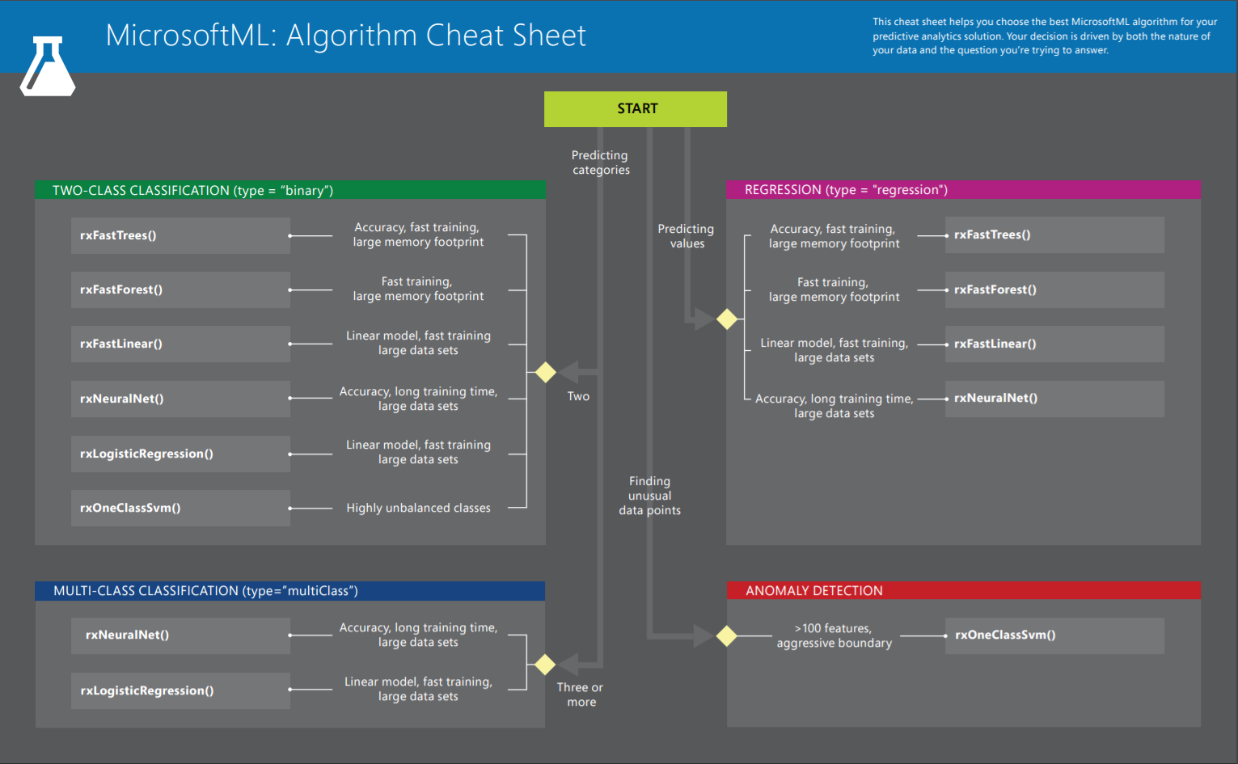
Base and scalable approaches comparison
27
Notes:
As of MRS 9.1, you can now run MicrosoftML in HDInsight to perform parallelized scoring (using the rxDataStep, rxExec, or rxExecBy function) and modeling (using rxEnsemble or rxExecBy), and you can use pre-trained models for images and text.

Slide 28
Operationalization, Model management & Deployment

Slide 29

Use case: scale the cluster for heavy computation
1. R Server Local Processing:
Data in Distributed Storage
R process on Edge Node
Data Scientists
Edge Node
Data Nodes/Worker Nodes
R
Head Nodes
R Server
HDInsight Gateway
RStudio

Slide 30
Use case: scale the cluster for heavy computation
1. R Server Local Processing:
Data in Distributed Storage
R process on Edge Node
Data Scientists
Edge Node
Data Nodes/Worker Nodes
R
R
R
R
R
Head Nodes
2. R Server Distributed Processing:
Master R process on Edge Node
Apache YARN and Spark
Worker R processes on Data Nodes
R
R
R
R
R
R Server
HDInsight Gateway
RStudio

Slide 31
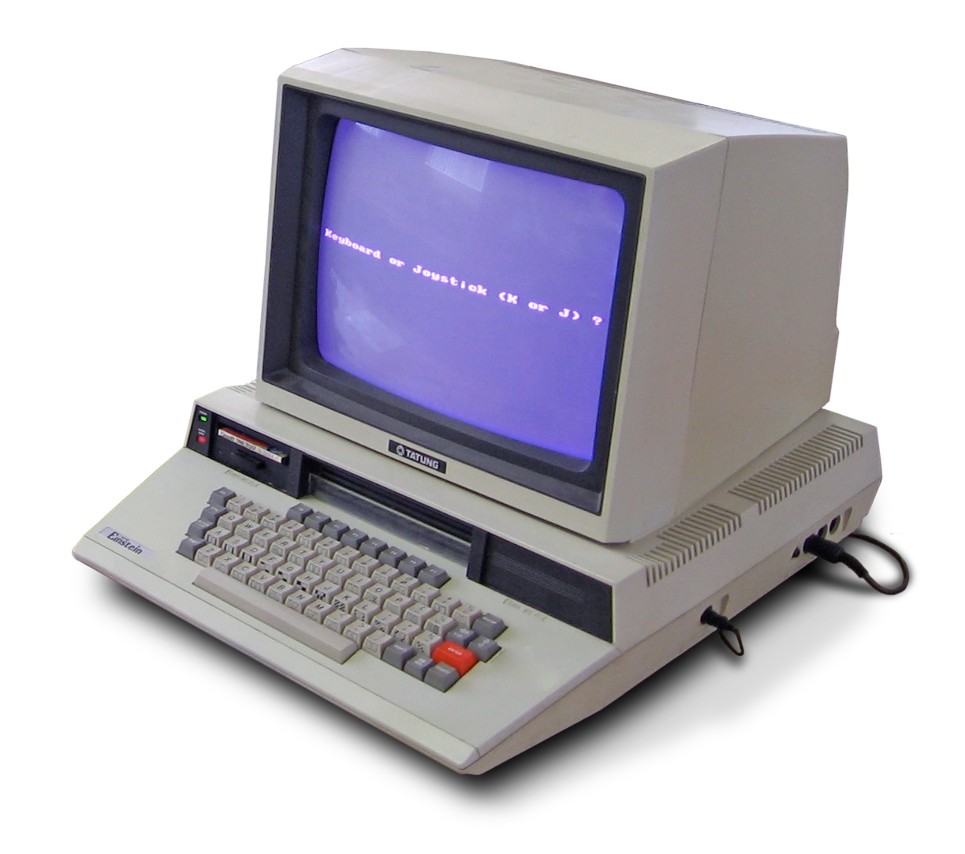
Use case: share cluster for data scientists and data engineers
Data Scientists
Edge Node
Data Nodes/Worker Nodes
1. Data Scientists go thru edge node for Rx applications
R
R
R
R
R
Data Engineers
Head Nodes
2. Data Engineers go thru head nodes for ETL tasks
R
R
R
R
R
R Server
HDInsight Gateway
RStudio

Slide 32

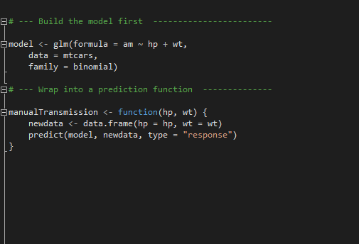
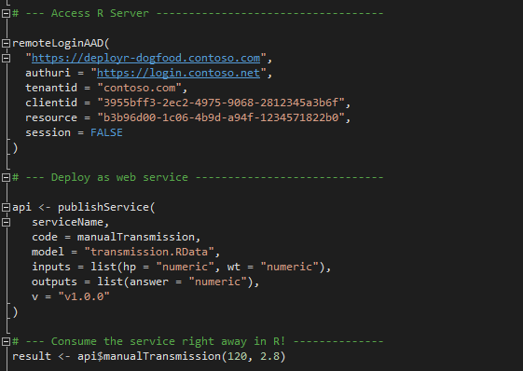
R Server Operationalization
Build the model first
Deploy as a web service instantly

Slide 33
Model management

Slide 34
Model Management Services

Slide 36
APPendix

Slide 37
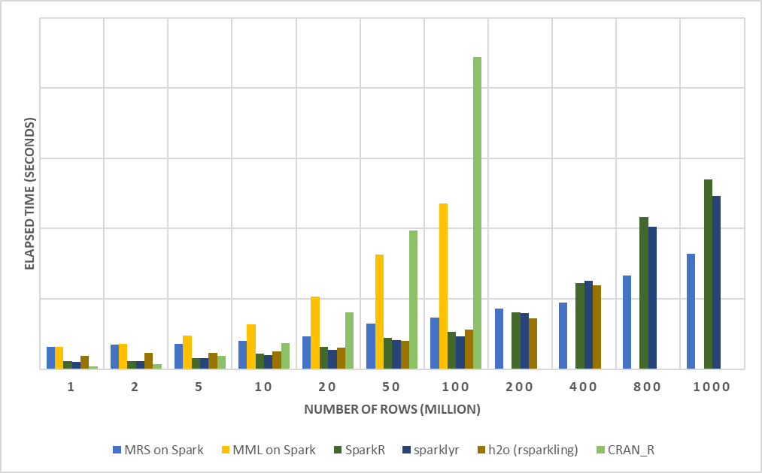
R Server on Spark - faster and more scalable
E2E Process:
Load Data from .csv
Transform Features
Split Data: Train + Test
Fit Model: Logistic Regression (no regularization)
Predict and Write Outputs
Configuration:
1 Edge Node: 16 cores, 112GB
4 Worker Nodes: 16 cores, 112GB
Dataset: Duplicated Airlines data (.csv)
Number of columns: 26
37

Slide 38
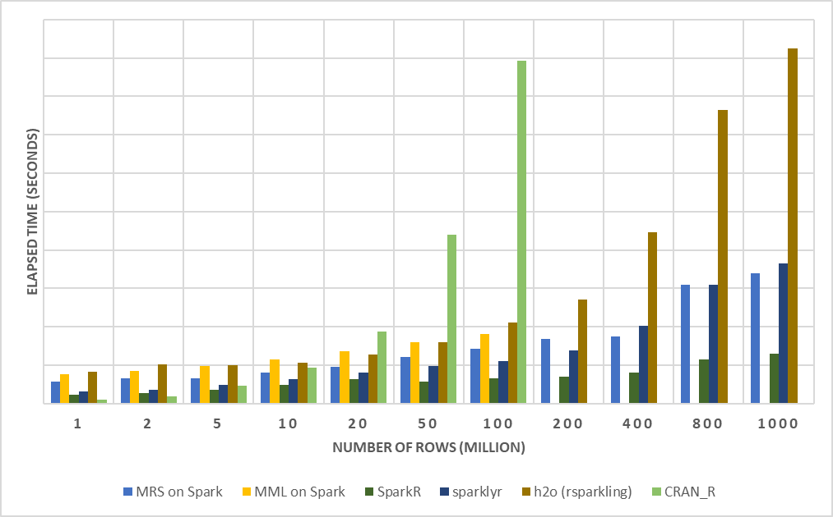
SparkR - outperform when loading data
z
Note: loading data using rsparkling package requires an additional data conversion from Spark DataFrame to H2OFrame. Better performance may be observed when handling the load using the h2o.importFile() function from the h2o package in order to avoid this extra data conversion step.
Load Data:
MRS on Spark: XDF
MML on Spark: XDF
SparkR: Spark DF
sparklyr: Spark DF
h2o: H2OFrame
CRAN R: DF
Configuration:
1 Edge Node: 16 cores, 112GB
4 Worker Nodes: 16 cores, 112GB
Dataset: Duplicated Airlines data (.csv)
Number of columns: 26
38

